Slide 1
Heat Sync, Inc.
Technology Presentation FY24 RFI101623
RFI Net-Zero Carbon Buildings, Fiscal Year 2024

Slide 2
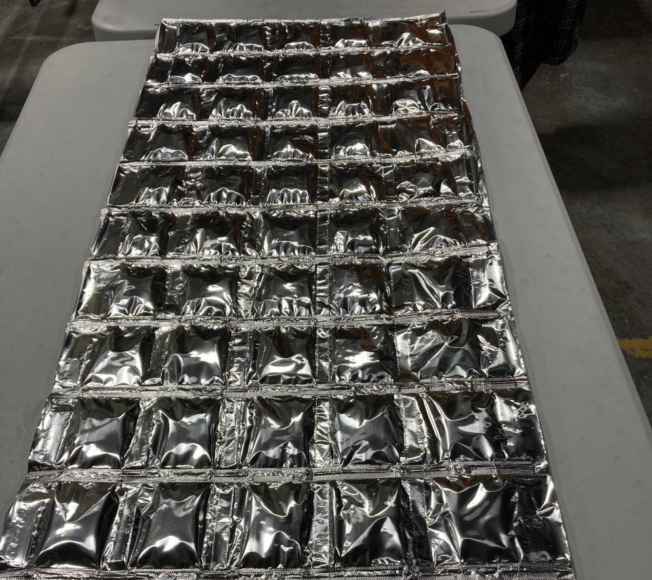
Heat Sync Phase Change Material (PCM) blankets
Heat Sync, Inc. Team:
Gary Gray, Co-Owner
Gary Bender, Co-Owner
Dr. David W. Yarbrough, Technical Advisor Henry Stueber, Program Manager
Pre-recorded presentation is strictly
limied to 7 minutes.
‘Leaders in Phase
Change Technologies!’

Slide 3
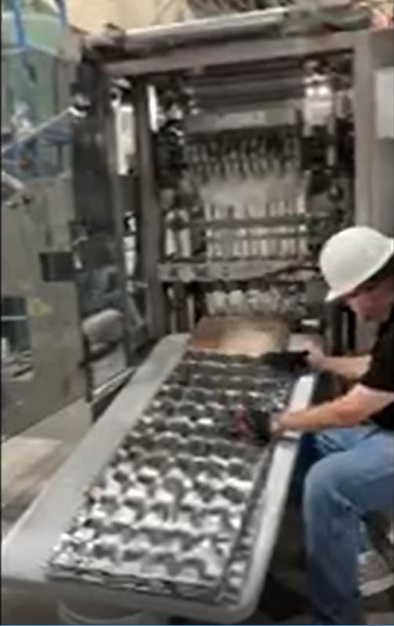
Presentation Outline
Technology Overview
Innovation
Maturity
Operations & Maintenance
Performance
Ideal Test-Bed Scenario
Value of Testing

Slide 4
Technology Overview
The Heat Sync product is made of a simple aqueous salt and clay solution, that absorbs thermal energy thereby maintaining a steady temperature within the facility or process piping. In addition, our product has an Infra-Red (IR) Reflective, outer wrapping (patented) to deflect IR wave lengths.
PCMs are used in the building envelope to reduce the utility load for heating and cooling by absorbing and desorbing heat from the space.
Vision for deployment with GSA / DOE:
Ready for installation into GSA portfolio facilities.
Inside Wall
Outside Wall
100ºF
77ºF
Heat Flow Occurs
PCM
Layer
Zero Heat Flow
77ºF
100ºF ●
77ºF
Work with DOE & Energy companies to be their energy
efficiency upgrade partner.
Insulation product for field units: ships, hospitals, tanks…
Inside Wall
Outside
Wall

Slide 5
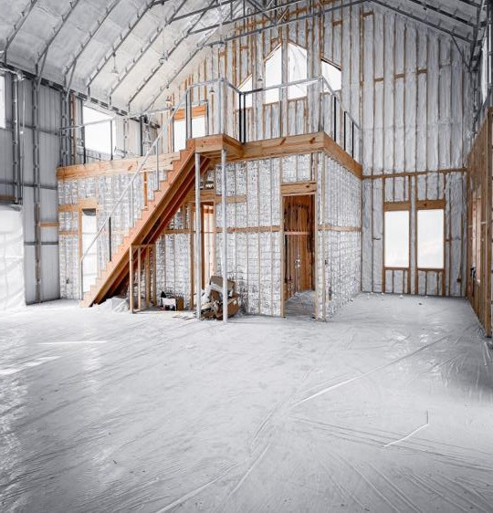
Innovation
Heat Sync PCM blankets:
Internal facility Peak load temp. reduced 40ºF-50ºF.
Reduces energy consumption between 20%-40%.
Potential to eliminate need for A/C.
Easily installed, no special skills or tools.
Non combustible – ASTM E-84, class 1 certified.
Packaging Industry product of the year 2022.
100% sourced and manufactured in the USA.
Multiple patents.
Current market competitors = standard insulation:
Fiberglass – spun silica, high energy need to produce.
Cellulose – flammable, moisture issues.
Foam – Expense, oil based, off-gassing.
Corporate Retreat Super Coffee Co.
Austin, TX

Slide 6
Laboratory Test Data
Grid Peak Power Load is Shifted
Benefit for Energy producers:
120.00
110.00
Normal Peak
By reducing and shifting the peak load demand by 4-5 hours, Heat Sync helps avoid Black or Brown Outs. In addition, Heat Sync may reduce and/or delay the cost of adding additional capacity.
100.00
90.00
80.00
70.00
60.00
4 hrs.
PCM Peak
1 28 55 82 109 136 163 190 217 244 271 298 325 352

Slide 7
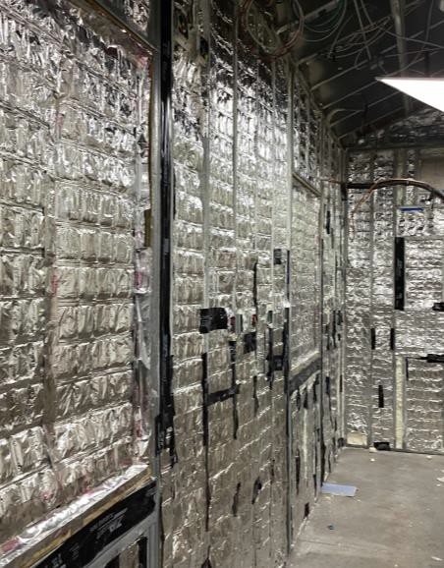
Maturity
Heat Sync is a new (2020) commercially available product that is under represented in the market place.
Our product is ASTM certified:
ASTM E-84, ASTM C-1784
There are no potential risks in an operational environment.
Market penetration is limited to localized applications:
US Marine Corps warehouse 29 Palms, CA
Sunpro Solar & ADT Solar - 30 residential homes in LA & TX
Super Coffee, Corporate “Barndominium”, Austin, TX
Tampa University, 2 Biology Laboratories
Current project – multiple homes & businesses for major utility, phase 1 roll out. Southern Company /Georgia Power Pilot
Specified by Leeds Platinum Architect group for Downtown Billings
Montana retrofitting project
US entry for Solar Decathlon: 1st place 2018; currently in 2024 entry.
Tampa University
Biology Labs

Slide 8
Operations & Maintenance
Installs into new or retrofit applications
Easily installed in walls, attics, ceilings.
Contractor training is available.
No special PPE required; No special tools required for install.
Do not need to vacate home/building during install.
No maintenance requirements, just install and experience the results.
20 year warranty.
Not food or animal nesting material.
PCM blankets can be moved and reused.
Safe to handle, no toxic chemicals.
Cost effective + Improves existing insulation performance

Slide 9
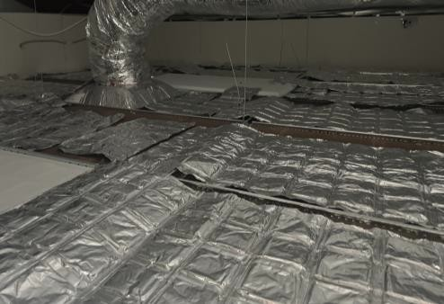
Performance
Installed cost = $4 sqft. (Typical)
Material Cost = $3 sqft
Installation cost = $1 sqft.
Lab test results = 40% - 60% HVAC energy reduction.
30 residential installation in LA & TX = 20%-30% total KwHr reduction.
ROI > 100%
Key driver for savings is correct melt point selected and the amount of Heat Sync installed. Regional Melt points are provided
Broader impact with GSA support:
Faster adoption rate and validation of energy savings potential.
Use in applications that require thermal management.

Slide 10
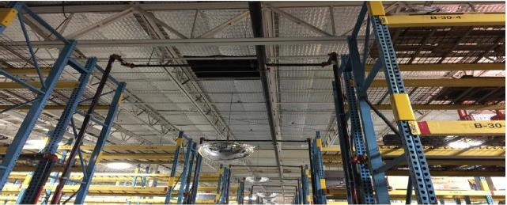
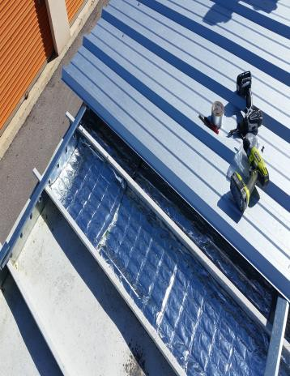
Test-Bed Scenario
Best environment for Installations:
US Marine Corps Warehouse 29 Palms, CA
Commercial facilities.
Military: warehouses, field hospitals, service centers.
Use in applications that require thermal management:
Barracks, Food storage; Medical stockpile warehouse
Heat Sync is manufactured to standard widths and desired lengths.
Recommend installation sites have KwHr usage measurement system,
for baseline metrics and future data collection / monitoring.
Ready to support GSA portfolio facilities projects.
We have and are working with energy companies to collect data as well as penetrate the larger market. Georgia Power Pilot.
New area for testing would be to use Heat Sync for HVAC duct work (new patent issued).
Commercial Bldg Reroofing with PCM

Slide 11
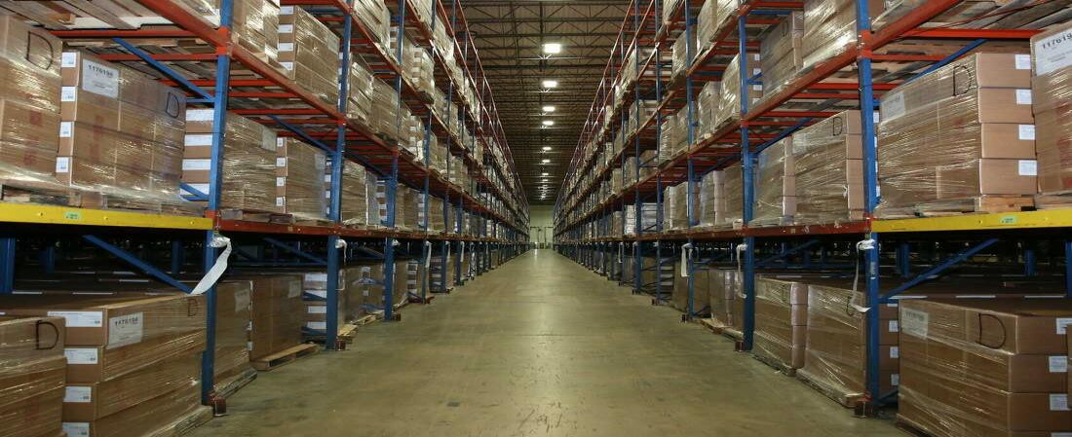
Additional Application Ideas:
Pentagon
Data Center
Strategic National Medical Stockpile
Military Garage / Vehicles

Slide 12
Value of Testing
We at Heat Sync, Inc., believe that utilizing the GPG-testbed evaluation, will assist us in expanding our reach to the broader customer base looking for energy efficiency products.
In addition, with GSA / DOE - GPG validation, more governmental entities would install Heat Sync and achieve their energy savings targets.
As a Veteran owned, small business, we will prove that Heat Sync significantly reduces energy consumption while providing a stable, comfortable, living and work space, and offers the potential reduce or eliminate the need for conditioned air.

